Slide 1

Quality project
Project is books full dataset

Slide 2
Describe of Dataset
The following information is a section classification of books in a public library, the classification was based on a table divided into the name of the book and a summary of the main information in terms of the author and the year of publication and the administrative classification of the general and detailed book and the price of the book

Slide 3
Describe of Dataset
Title
That refer to title of books.
There is 8987record .
There is text type of record.
.

Slide 4
Describe of Dataset
Author
That refer to author of books.
There is 8987record .
There is text type of record.

Slide 5
Describe of Dataset
Description
That shows which section of book.
There is 8987record .
There is text type of record.
.

Slide 6
Describe of Dataset
Pages
That refer number of pages .
There is 8987record .
There is numeric type of record.
.

Slide 7
Describe of Dataset
Publisher year
That refer date of publish .
There is 8987record .
There is date type of record.
.

Slide 8
Describe of Dataset
Publisher
That refer name of publisher ,that published the book .
There is 8987record .
There is numeric type of record.
.

Slide 9
Describe of Dataset
Cover
That refer to kind of cover of the book .
There is 8987record .
There is text type of record.
.

Slide 10
Describe of Dataset
Category
That refer type of writing of the book .
There is 8987record .
There is text type of record.
.

Slide 11
Describe of Dataset
Subcategory
That refer to describe details of writing of the book.
There is 8987record .
There is text type of record.
.

Slide 12
Describe of Dataset
Price
That refer price the book .
There is 8987record .
There is numeric type of record.
.

Slide 13
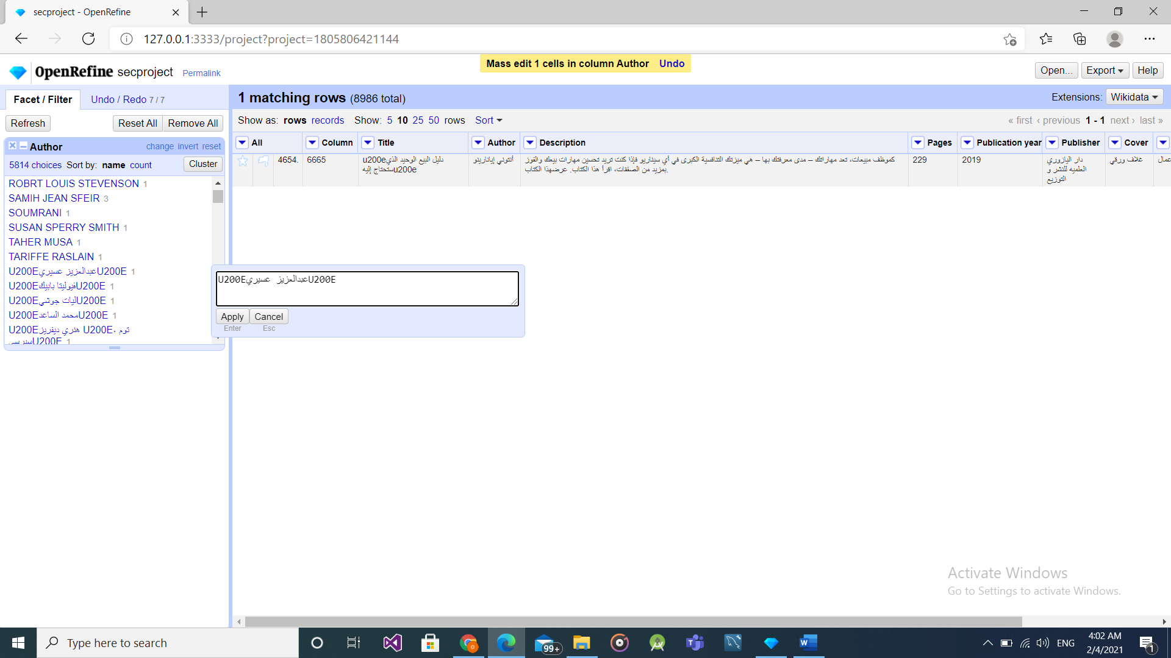
Clean dataset
Firstly, I tried to clean mistake by edit text, For each column .

Slide 14
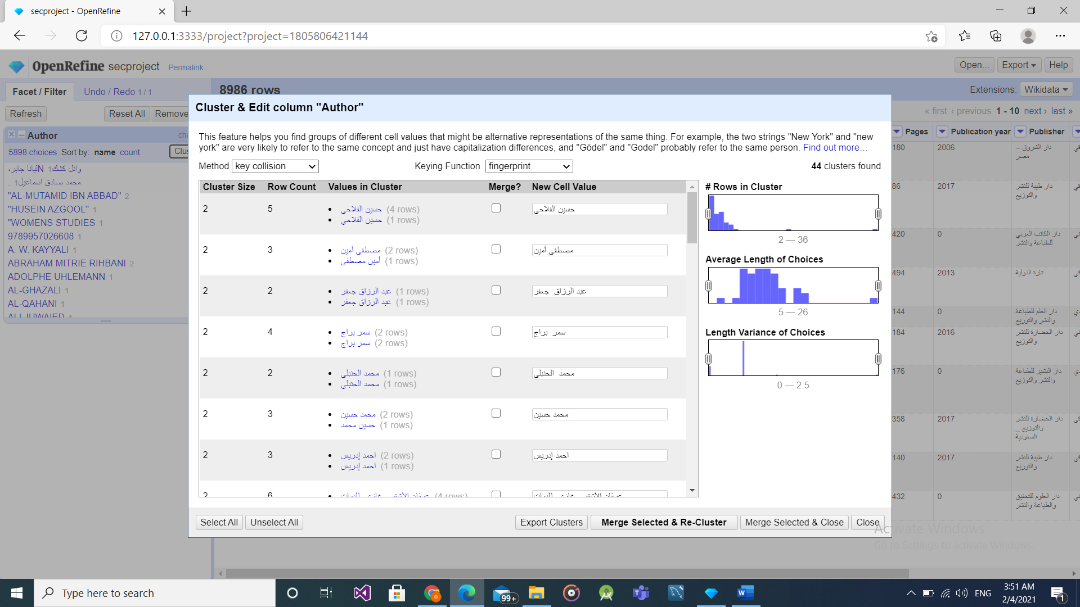
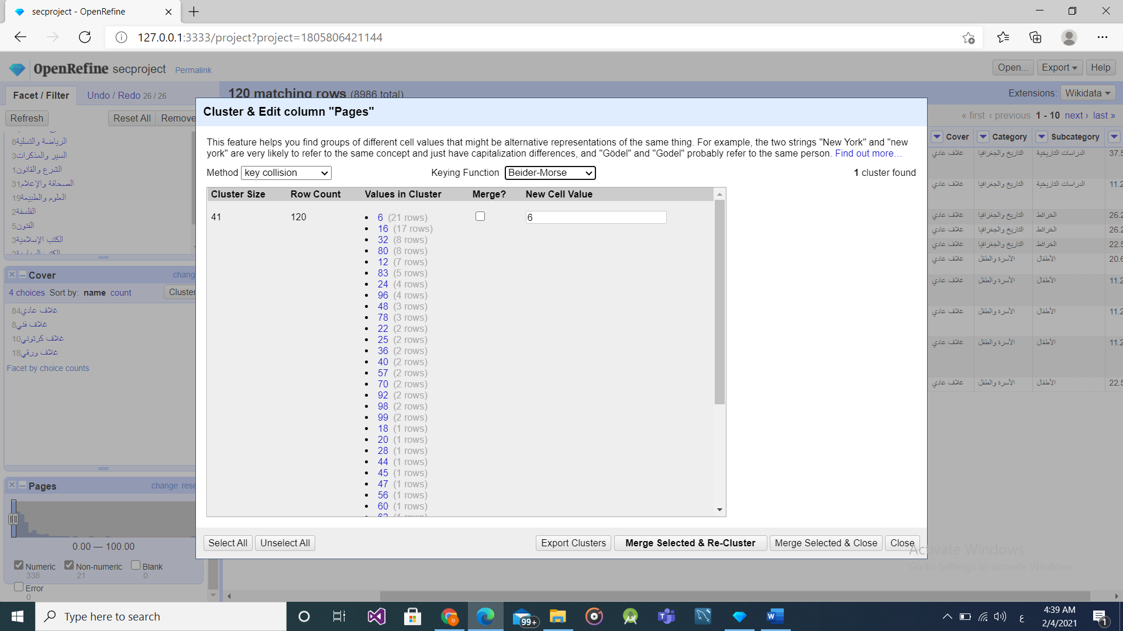
Clean dataset
As a result of using “ edit cell” was some mistakes so , I tried use “cluster” .
I found it more easy and more effective in editing for each column

Slide 15
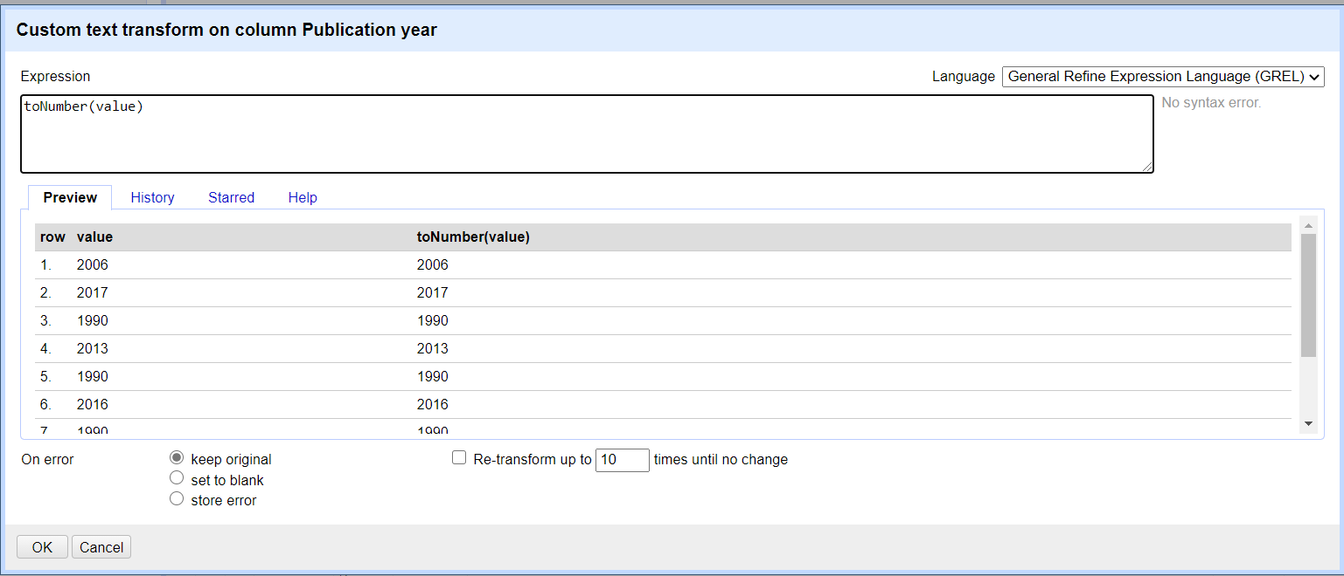
Clean dataset
Secondly , I converted from text value to numeric value.
By >> edit cell>>transform>>to Number(value).

Slide 16
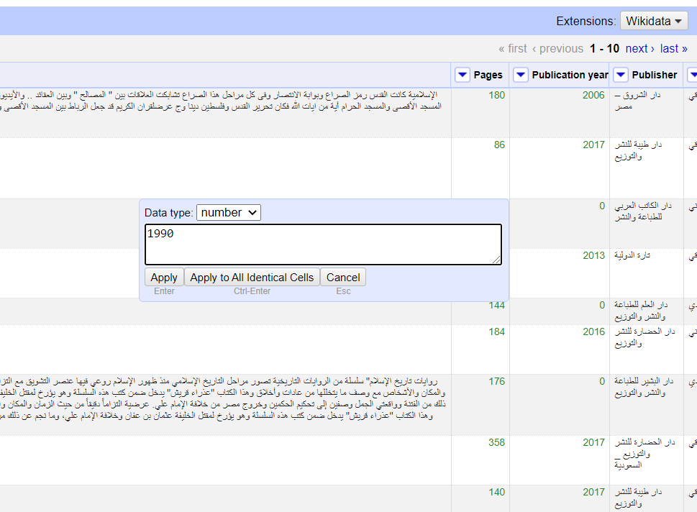
Clean dataset
Minimum year =1990
By>> select 0>> write 1990 >>apply to all.

Slide 17
T-test (price T-test)
Now, we use R studio
First we read excl file in R studio
By>> install package>>install.packages("readxl").
Load library >>library("readxl").

Slide 18
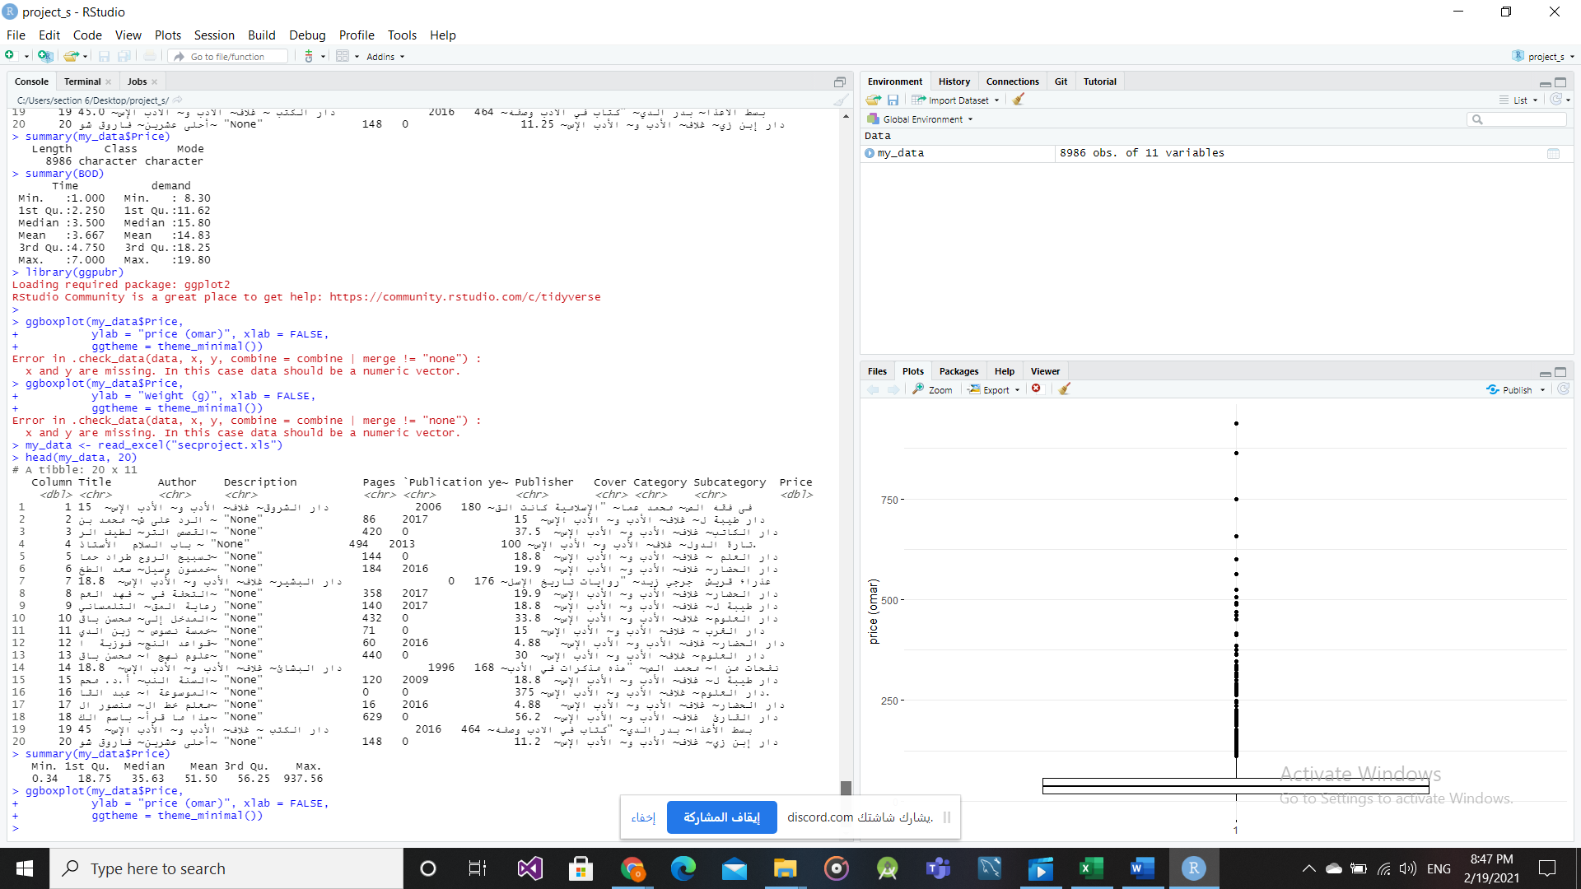
T-test (price T-test)
Second, we show some records .
And we calculated 5 summary number for price.

Slide 19
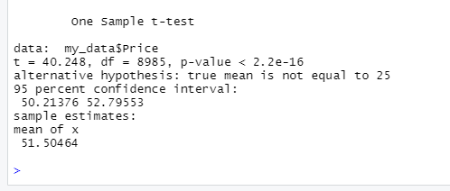
T-test (price T-test)
Third, we calculated t test for price.

Slide 20
Visualization (price)
Visualize your data using box plots

Slide 21
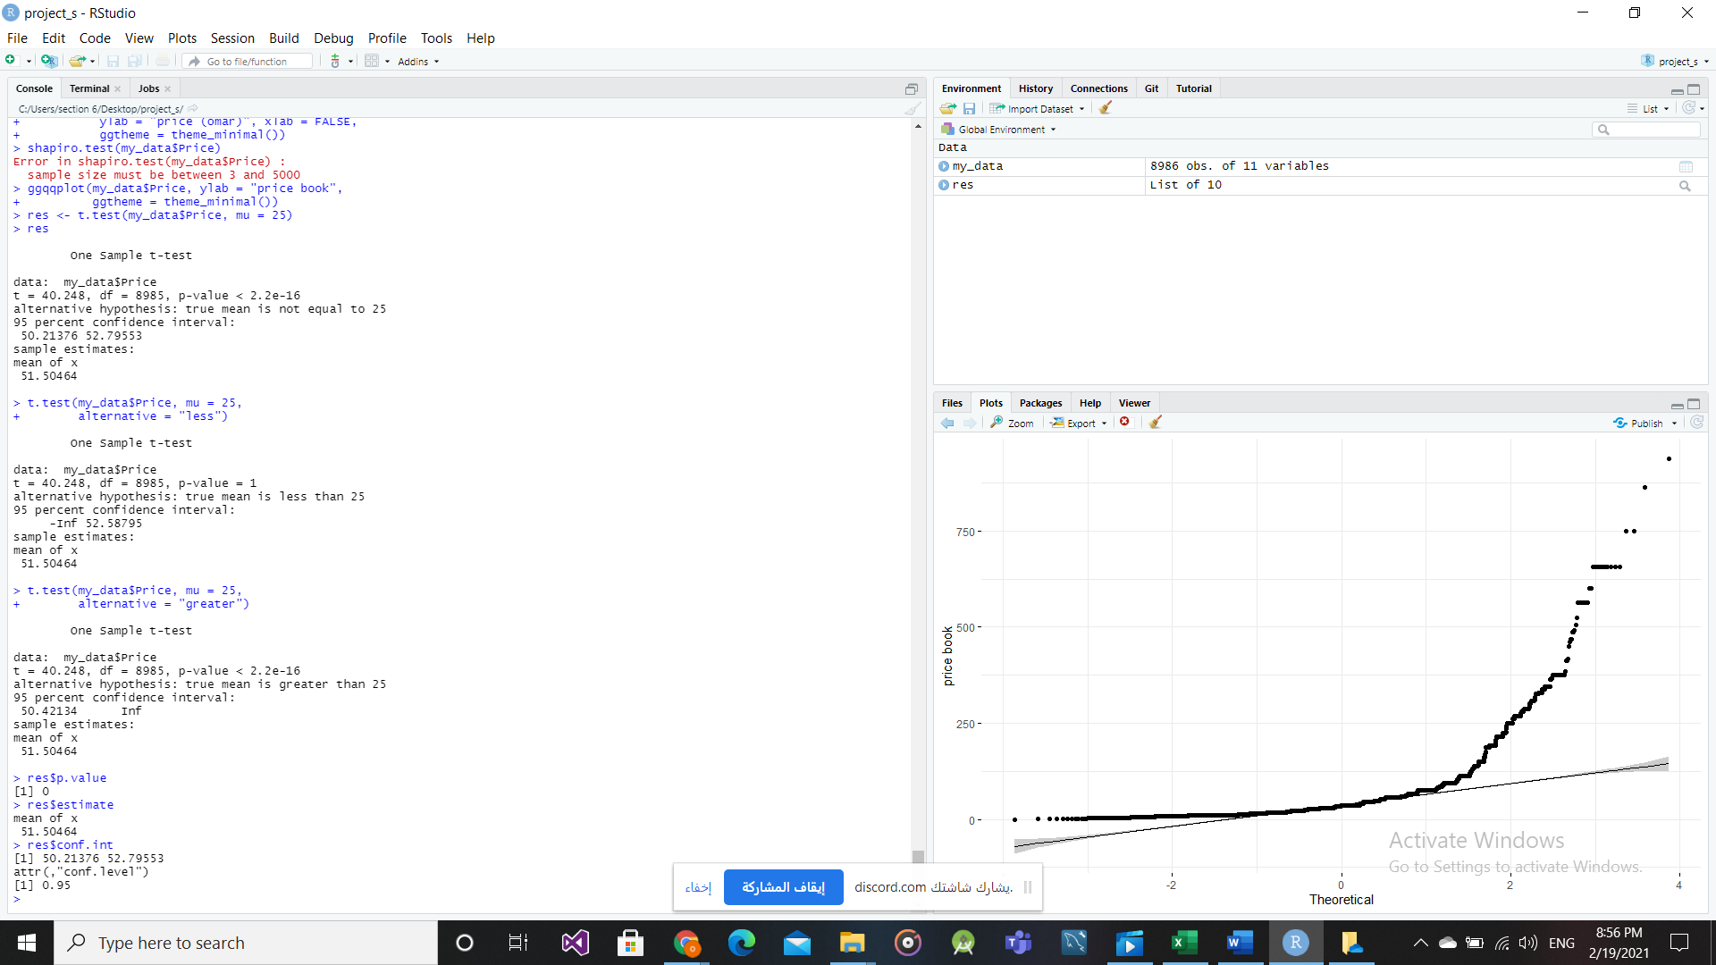
Visualization (price)
Visual inspection

Slide 22
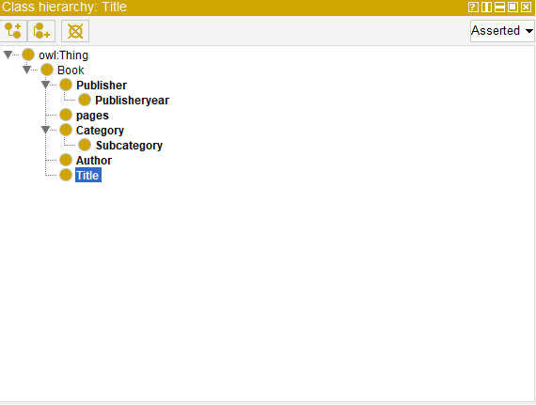
Semantic data integration

